Slide 1

Virtual Police System
Guide: Dr. Kasturi Dhal
Assistant Professor, Department of Computer Science and Engineering
Team Members;
Tirlochan Singh
Guru Sauri Vargav
Ashutosh Rath
Chiranjibi Rout

Slide 2
Problem Statement
Computer and Internet are the most brilliant gifts of Science. The importance of internet as an all pervasive medium of the future has been well recognized. It provides better way of communication and interaction. As we all know that in present world every facility is available on internet like shopping, banking etc. then why not FIR Launching Facility also.
""" Designing a web portal and Apps to capture all the details with respect to identity of complainant, details of the incidence or crime committed will extract supplementary information to capture ingredient of the crimes committed, identity of criminals and likely witnesses the same would be converted in text format as an FIR which would be stored securely using IPFS, a decentralized and distributed architecture of file storage providing enhanced security features and easy interface. """

Slide 3
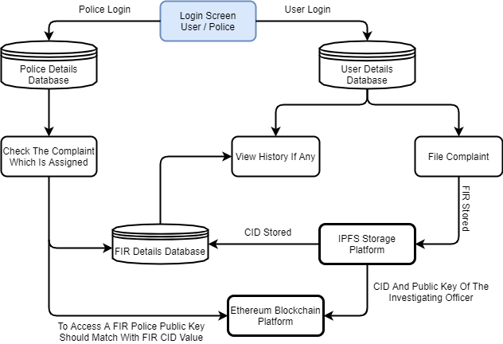
Flow Diagram

Slide 4
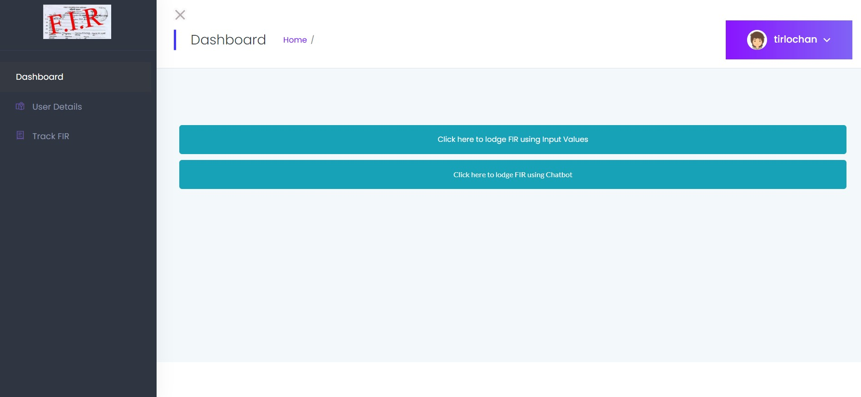
Work Currently Executing
User Home Page

Slide 5
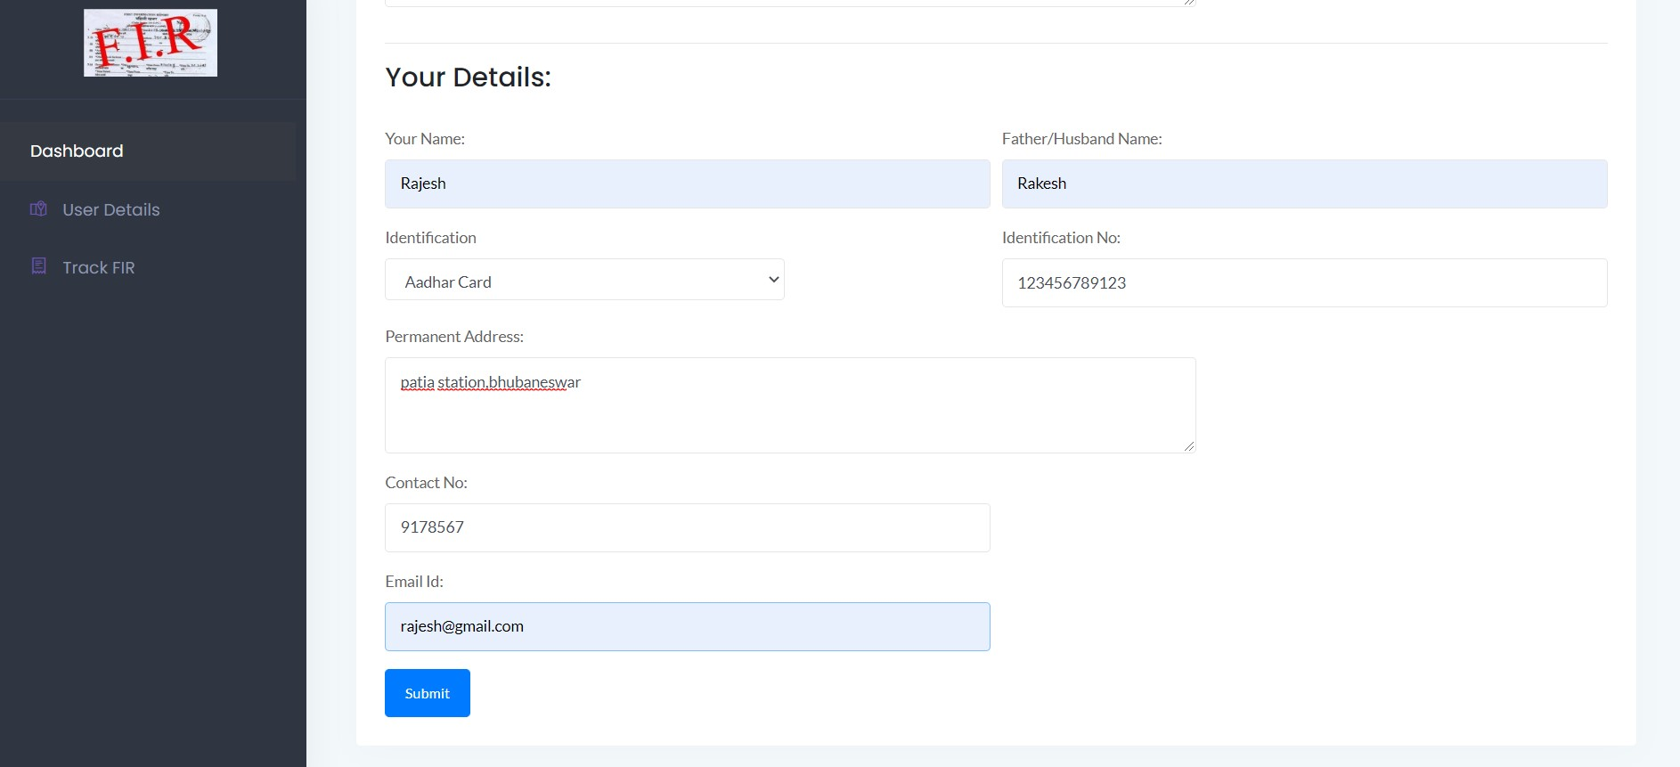
Launching FIR
By Inputting Values

Slide 6
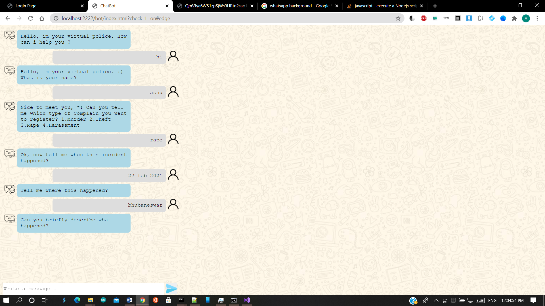
Launching FIR
By Using ChatBot

Slide 7
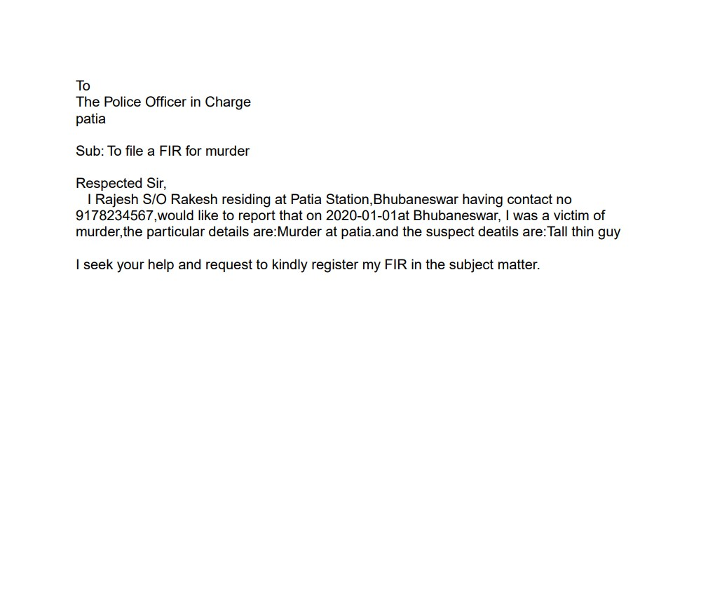
Generated PDF format of FIR

Slide 8
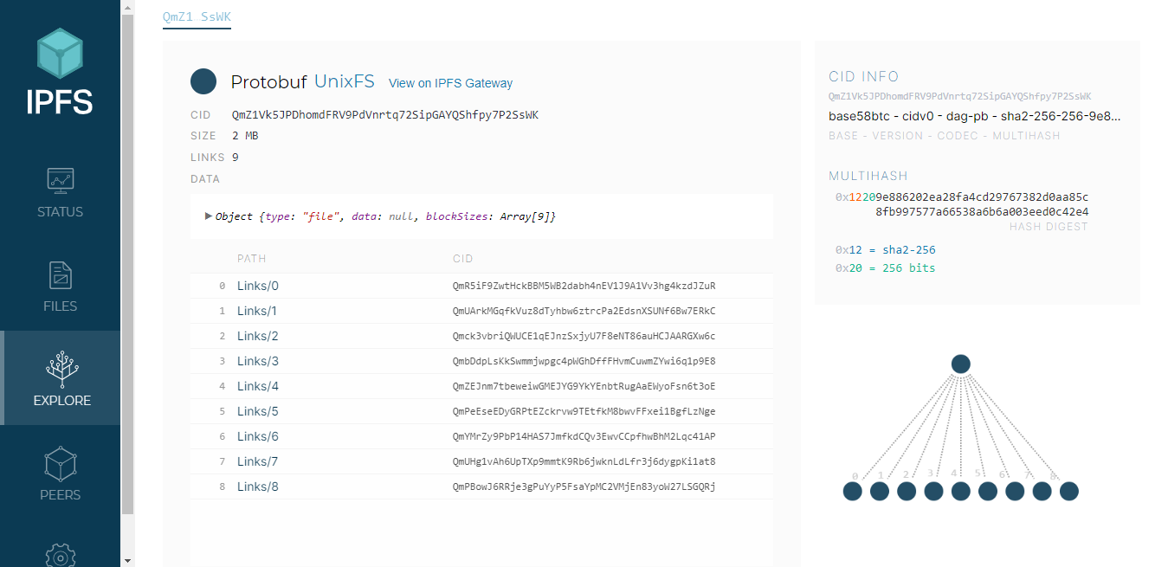
FIR Stored in IPFS

Slide 9
Conclusion
In the modern world, the use of computers and Mobile phones is becoming rampant. More over, recent developments in the ICT Industries has revolutionized and consequently brought about a paradigm shift in the way activities are accomplished. As a result the, crime reporting system needs to embrace these new technologies. This project has presented a simple, convenient, cost-effective, but efficient online crime reporting system with a user-friendly, sensitive and intelligible web interface. Whereby it can be accessed at any time provided there is internet connection.

Slide 10
Contribution And Future Work
Introduction of animated avtar to make the project livelier.
Auto escalation facility for cognizable cases
Detecting Fraud FIR's
Users can view the progress of their complaint online.
Making the platform more user friendly by using voice assistant to record user FIR's.
Encouragement of police enforcement through a reward system based on case solved.

Slide 11
References
https://ipfs.io/
https://medium.com/
https://blockgeeks.com/
https://www.provendb.com/

